Slide 1


Building Web Applications with R and Shiny
03/01/15
Notes:
Booz Allen Hamilton Standard Colors
Colors should be used in the color pairs whenever possible. Do not mix and match colors, use pairs together as shown.
Black, White and Gray can be used with any of the other colors.
Purple Pantone 2765
R 12
G 4
B 79
Green Pantone 357
R 15
G 67
B 24
Blue Pantone 2 88
R 11
G 31
B 101
Black
Pantone Cool Gray 6
R 158
G 158
B 158
Red Pantone 485
R 252
G 5
B 14
Yellow Pantone 3965
R 232
G 244
B 4
Aqua Pantone 319
R 126
G 204
B 189
White

Slide 2
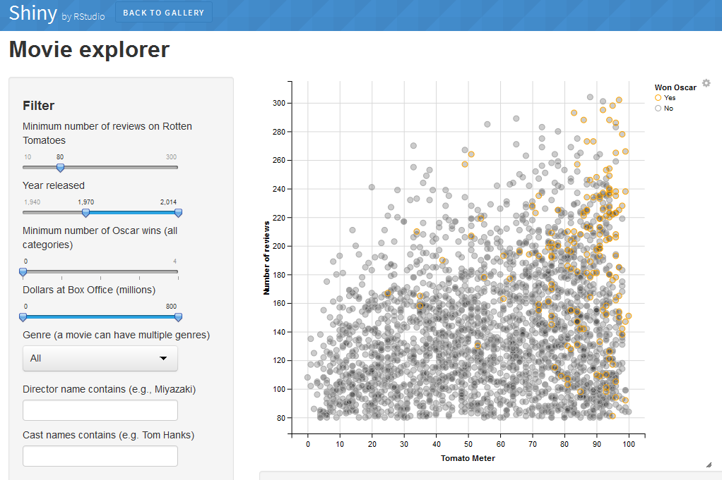
What is shiny?
shiny is a package designed to allow R users to develop interactive web applications without the need for HTML, CSS, or Javascript.
Shiny Gallery - http://shiny.rstudio.com/gallery/
It is especially well suited to rapid prototyping as building a polished web application can be done in as short as an hour using the templates included in the library.

Slide 3
Shiny 101
Shiny applications are made up of two components…
A visual template, or user interface, for their application and create toggles/buttons for user interaction.
The functionality of the application as part of the backend, or server, which stores functions that use all of statistical libraries (e.g. hypothesis testing).
These components are stored in two separate R files (ui.R and server.R) which govern the user interface and server for the application respectively.
Even though these files are separate, be sure to coordinate development between the two files as a user interface is nothing without functionality behind it and functionality is nothing without the ability for the user to access it.
When beginning an R shiny application, you should create a new folder in your current working directory to contain the ui and server files as this keeps development process organized and will prevent any issues with running the application later on.

Slide 4
First Steps
Before writing any code, it is important to map out your desired application both in terms of user interface and server functionality. This could be a hand-drawn sketch or an outline of the application’s features. While the plan might change during the development, it will be much easier to develop a pre-defined application than to develop one on the fly.
For our purposes, let’s try to create a simple web application that lets users perform changepoint detection on time series data. The user interface will allow the user to choose an algorithmic approach using a radio button and the results will be displayed graphically (as a plot of the detected segments) and numerically (listing the changepoints).
To begin, create a folder in your working directory with the name of your application (try to avoid spaces or special characters in the name) and create two blank R files called “ui.R” and “server.R” which will house the user interface and server components.

Slide 5
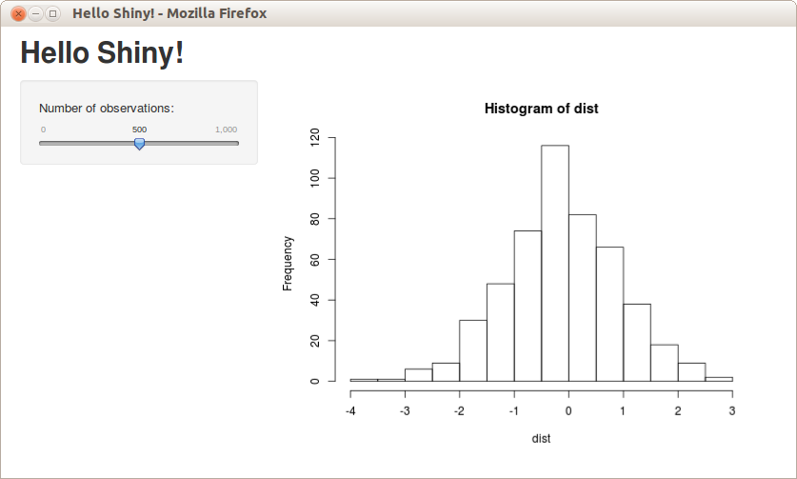
UI: Layouts and Panels
Shiny provides several templates for the user interface for you the choose from. These templates are made up of layouts (a visual design for the entire page) and panels (selected elements that are placed inside of a layout).
Here’s an example of a simple sidebar layout with a few panels…
titlePanel
sidebarPanel
mainPanel

Slide 6
UI: Layouts and Panels (CONT’D)
Sidebar layouts are the most popular for shiny applications as they are easy to implement and visually appealing, but there are also other types of layouts (e.g. grid layout, split layout).
For more information about available layouts, check out the Shiny Application Layout Guide – (http://shiny.rstudio.com/articles/layout-guide.html)
No matter what layout you choose to build your user interface around, you can mix and match panels within that layout as you see fit.
There are several types of panels in shiny
sidebarPanel – A general panel that contains the visual elements for the side of the page, usually the toggles for user interactivity.
titlePanel – A simple panel that generates a large piece of text which usually contains the title for the application.
mainPanel – This panel normally contains the outputs or primary functionality of the application (e.g. plots, tables).

Slide 7
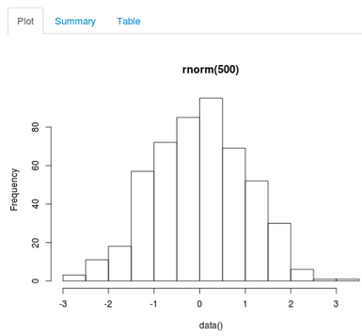
UI: Layouts and Panels (CONT’D)
tabsetPanel and tabPanel – These panels work together to create tabs for the user to navigate between different pieces of output.
tabsetPanel
tabPanel
mainPanel

Slide 8
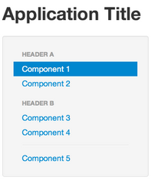
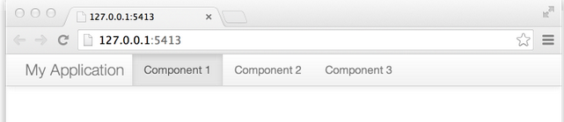
UI: Layouts and Panels (CONT’D)
navlistPanel and navbarPanel – Similar to the tab oriented panels, these panels create a list of links to the side of an application or a top-level horizontal bar for users to navigate between different outputs.
sidebarPanel
navbarPanel
navList

Slide 9
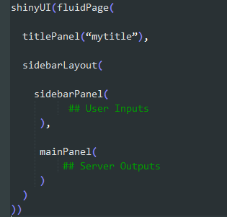
UI: Coding the Layout and Panels
Most ui.R files will have the same general structure…
Feel free to use this exact code to start any ui.R file you develop.
(Necessary page setup)
Indenting your code makes it easier to recognize errors and organizes your code nicely.
All of the toggles (e.g. buttons, sliders) will go here.
All of the server outputs (e.g. plots, tables) will go here.

Slide 10
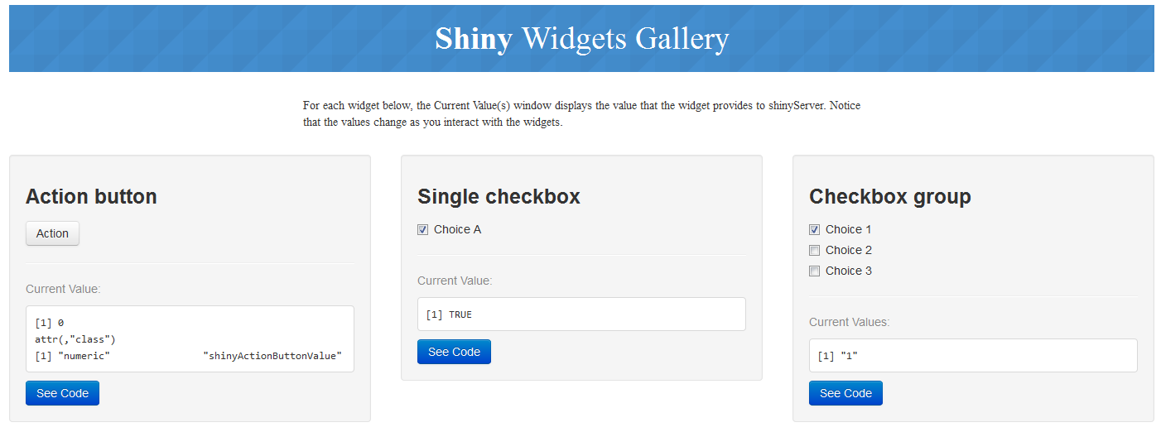
UI: Input Widgets
After you’ve selected a layout and some panels, the next step is to choose input widgets for user interactivity. To explore and test available input widgets, check out the Shiny Widget Gallery (http://shiny.rstudio.com/gallery/widget-gallery.html ).
Remember that whatever input widgets you choose will have to link back to the server functionality so it is normally best practice to pick a widget whose inputs are limited to just what you will need to generate the outputs.
E.g. Do not give users a text field to enter any string if the application will only react to a few select strings. Instead, opt to use a radio button which limits the user’s choices to a few strings.

Slide 11
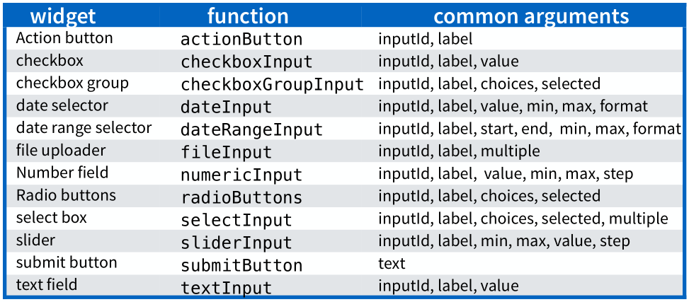
UI: Input Widgets (CONT’D)
Each input widget has the same general set of parameters:
inputId - a unique name for the widget
label - a piece of text to accompany the widget (usually instructions to the user)
choices or min/max – a list or numeric range of the limited set of values available to the user
value or selected – the initial or default value(s) for the input when the application first loads
Source: http://www.rstudio.com/wp-content/uploads/2015/02/shiny-cheatsheet.pdf

Slide 12
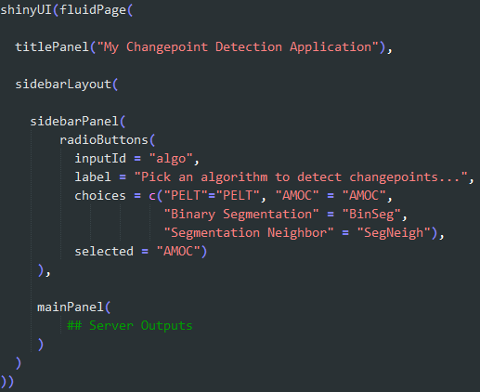
UI: Coding the Input Widgets
Given our application plan, we’ll choose to add a radio button widget for the user to select an algorithmic approach to detecting changepoints…
Using this syntax for the choices parameter (“NAME” = “VALUE”), allows you to display the choices for user cleanly as the names but will send the server file the value for calculation.

Slide 13

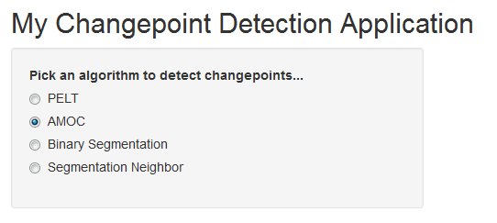
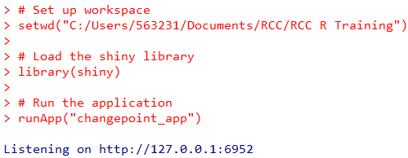
UI: Testing the UI Elements
Before we can see what the application looks like thus far, we just need to fill in the server.R file with the following piece of code…
After you have set up the ui.R and server.R files, the next step is to run the shiny application. To do this, you will need to load the shiny library and use the runApp() function which takes the directory of the folder containing the ui.R and server.R files as its parameter.
To stop the application, just hit the Escape key in the R console.

Slide 14
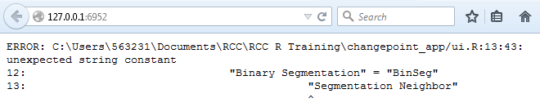
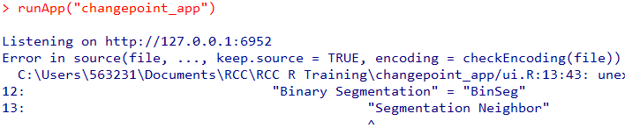
UI: Testing the UI Elements (CONT’D)
Most of the time, a shiny application will fail to load on the first try due to syntax issues (E.g. a missing parenthesis or comma). If the application failed to load properly, then R will print describe the error that caused it to crash in the console and in the application.
Sometime the error message will be vague or just generally unhelpful. In that case, try removing the widget or panels one at a time and rerunning the application. This will at least help narrow down the source of the issue and then you can begin to hone in on the root cause.

Slide 15
Server: Inputs and Outputs
The server.R file is actually a giant function that takes in all the user inputs as its parameters and returns results to the specified panels in the ui.R file (usually the main panel).
All of the user inputs are passed to this function as a list where the values the user has selected are the components and the names of these components are the unique inputId assigned to the input widgets.
E.g. In our sample application, the user’s choice of algorithm choice would be stored in input$algo.
To pass output back to the user interface, two things are required.
The desired output has to be passed through one of a series of render functions. The results of this render function are then passed to a list, called output, where the components are the outputs and the names of the components are unique names assigned in the server.R file.
Each rendered output needs dedicated space in the user interface. This is done by placing an output function in ui.R file where that output should appear and passing it the unique name assigned to the output in the server.R file.
Each render function has an accompanying output function…

Slide 16
Server: Inputs and Outputs (CONT’D)
Type of Output | Render Function (server.R) | Output Function (ui.R)
Plot | renderPlot | plotOutput
Simple Table | renderTable | tableOutput
Javascript-enhanced Table | renderDataTable | dataTableOuput
Image | renderImage | imageOutput
Text | renderPrint | verbatimTextOutput
User Interface elements | renderUI | uiOutput
Be sure to pass to correct type of output to correct render and output functions otherwise it will not display correctly.
A javascript-enhanced table is a DataTable which you can learn more about here: http://www.datatables.net/
That last render and output function are used for creating reactive UI elements (more on that later).

Slide 17
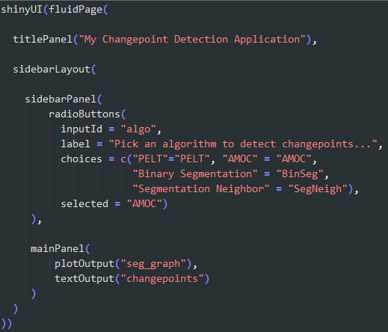
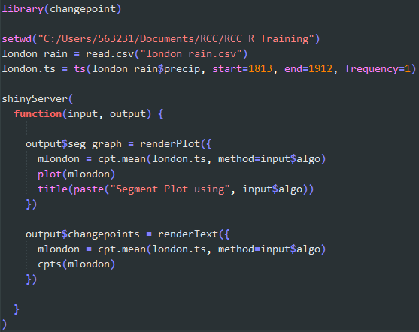
Server: Coding the Output
Per the application plan, we’re going to add output for a plot (the segment plot) and some text (the list of change points)…
Notice that the render functions have parentheses and curly braces.
ui.R
server.R

Slide 18
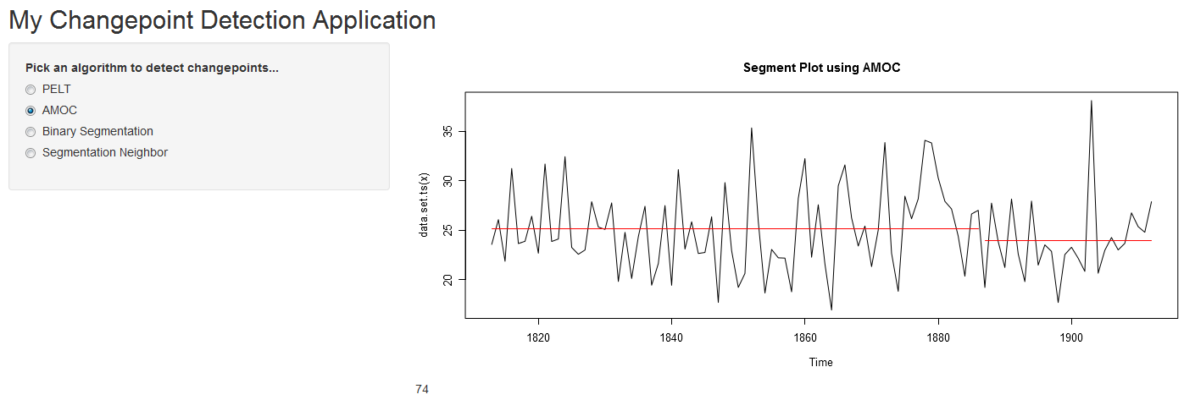
Server: Coding the Output (CONT’D)
This code yields the application we outlined at the beginning…
While this application works as intended, the aesthetics leave something to be desired. Additionally, there is duplicative code in the server.R file that creates the mlondon object twice (once for each output).

Slide 19
Adding Some UI Polish
Let’s deal with the aesthetics first. The outputs in the main panel are misaligned to the user inputs in the side panel. To address this, we will add some length to side panel by adding some information about the application and the data being displayed.
For explanatory text, shiny provides a helpText() function that formats this type of text nicely in the side panel.
Next, we’ll change the size of the graphic to align with the side panel by passing the plotOutput function a height parameter in pixels, abbreviated as px (the default size of plots in shiny is 400px). After some trial and error, the ideal plot size appears to be about 325px.
Finally, the main panel could some visual structure and organization. By placing our outputs in a tab panel with two tabs (one for the plot and one for the change points), the application looks much better.

Slide 20
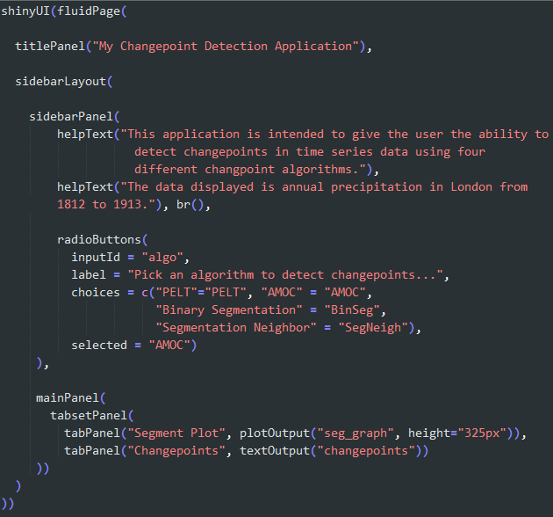
Adding Some UI Polish: Code
Splitting the explanatory text into two separate helpText functions will create a paragraph break between them.
The br() function adds a line break between text and/or widgets.
The first parameter of tabPanel is the display name for the tab.

Slide 21
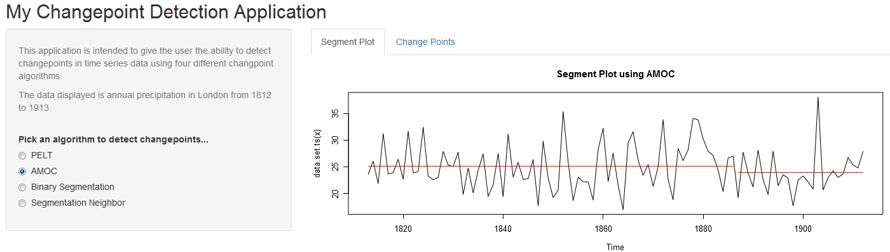
Adding Some UI Polish: Results
Before
After

Slide 22
Optimizing the Outputs: Reactive Functions
Now for the server.R file improvements. The fact that the mlondon object is being calculated separately in both render functions is inefficient. Depending on the size of the time series data, this could greatly slow down the application and hamper the interactivity.
Fortunately, shiny provides a solution for this with reactive functions which handle the processing of user inputs once for the different render functions. Reactive functions will perform this processing once and can return the results to multiple render functions.
Like render functions, reactive functions also use a combination of parentheses and curly braces.
An effective reactive function will not only optimize the generation of the outputs, but will also make the code much more readable.
Be careful not to overload reactive functions as they will be rerun each time a user changes the inputs. It may take some experimenting to figure the optimal placement of calculations between the reactive and render functions.

Slide 23
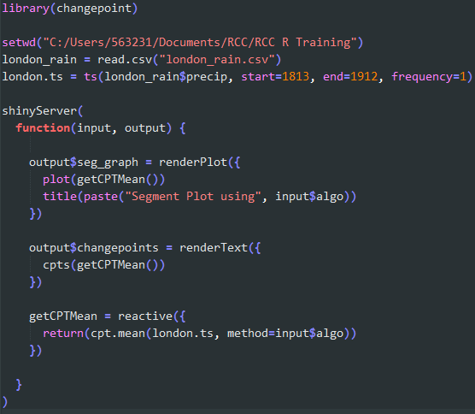
Optimizing the Outputs: Code
BEFORE
AFTER

Slide 24
Adding Reactive UI Elements
Now that the function is aesthetically pleasing and optimized, we can take the time to further build on the functionality of the application using reactive user interface elements. This is done using the combination of the renderUI function in the server.R file and the uiOutput function in the UI file.
These functions work similarly to the others, but instead of returning a plot the renderUI function will return code to place in the ui.R file (E.g. a new input widget). Just place any code that you would include in the ui.R file inside the renderUI function.
The advantage of doing this is that you can have the user interface react with the user’s input choices. In our case, we are going to have the application give the user an additional input widget (a slider) when they choose a specific algorithm to give them further control over how many changepoints to detect.

Slide 25
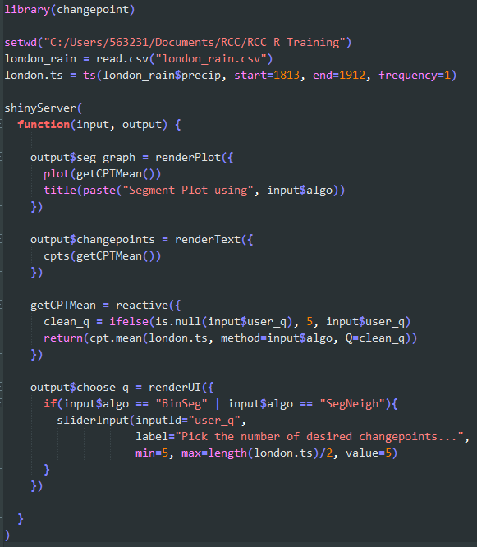
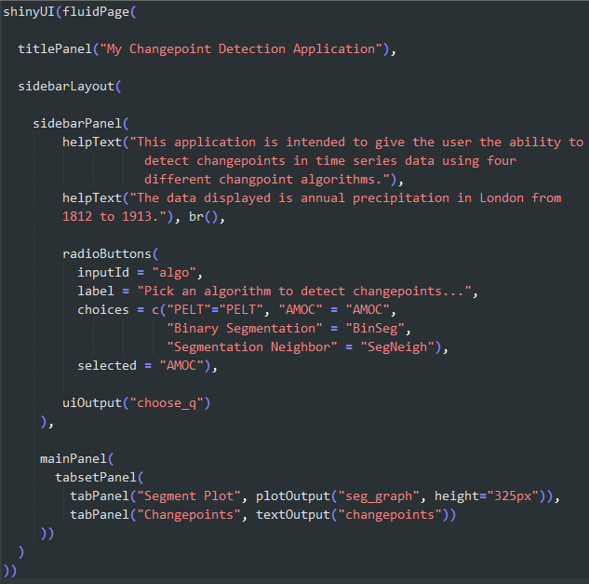
Adding Reactive UI Elements: Code
ui.R
server.R

Slide 26
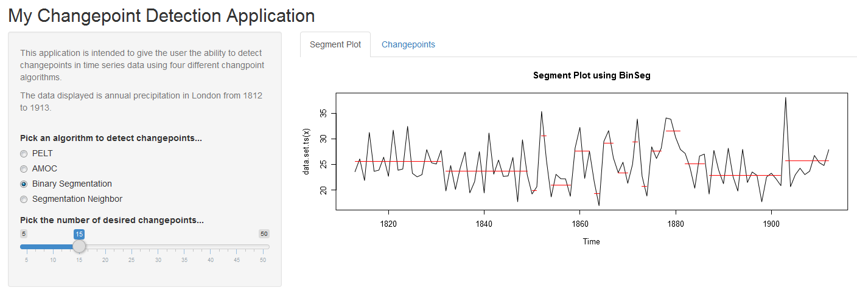
Adding Reactive UI Elements: Results
Because the renderUI contained an if statement, this slider only appears for certain choices of algorithms.

Slide 27
Recap: Steps to Developing A Shiny App
Before coding, design and plan your application’s layout and desired functionality.
Create the ui.R file. Then, drop in the user interface layout, panels, and input widgets that fit your application’s needs.
Create a blank server.R file and run the application to make sure that the user interface displays properly and that there are no syntax errors.
Fill out the server.R and ui.R files with the render and output functions necessary to implement the desired functionality at the most basic level.
Try running the application with the newly coded outputs and debug if necessary.
Add a layer of polish to your application by moving around the user interface elements to give the application a professional look.
Optimize the server.R file by looking for duplicative code and adding reactive functions.
(Optional) Add reactive user interface elements to improve functionality and reactivity.

Slide 28
Closing Thoughts
This presentation only scratched the surface of what is possible with shiny. For more information and tutorials on different topics (E.g. building custom input widgets), check out the official Shiny site at http://shiny.rstudio.com/articles/.
While knowing HTML, CSS, and Javascript are not necessary, they can greatly improve the appearance of shiny applications. Shiny supports most major HTML5 tags and the inclusion of custom CSS.
The popularity of the shiny package has also created a cottage industry of R packages that add additional functionality to shiny applications (E.g. the ability to embed D3.js visualizations). These R packages are listed on the official Shiny site as well.
Developing a shiny application from scratch can sometimes be daunting at first, so it may be easiest to edit the code for an existing shiny application. Over time, you’ll end up recycling code from your own shiny applications.

Slide 29
Source Materials
Official R Shiny Tutorial - http://shiny.rstudio.com/tutorial/
Shiny Application Layout Guide - http://shiny.rstudio.com/articles/layout-guide.html
Shiny Cheatsheet - http://shiny.rstudio.com/articles/cheatsheet.html

